Slide 1

Computer Programming for Engineers
Week 11 Lecture 1
Nov. 8, 2022
Lecturer: Mohammad Mahdi Javidan
College of Engineering, Sungkyunkwan University
Fall Semester 2022

Slide 2

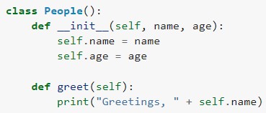




Object-Oriented Programming (OOP)
Procedure-Oriented Programming (POP) consists of:
A collection of variables
Data structures
A list of instructions and functions to accomplish different tasks
Object-Oriented Programming (OOP)
Consists of classes and objects
The class models real-word entities
Its is a logical grouping of data and functions
Objects combine data (known as attributes) and behaviors/functions (known as methods)
An object is an instance of the class with actual values
College of Engineering, Sungkyunkwan University

Slide 3
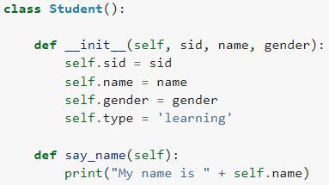
Class
A class named Student
Attributes:
sid (student ID)
name
gender
type
Methods:
say_name
__init__ initializes the attributes
self.attribute can access the attributes
College of Engineering, Sungkyunkwan University

Slide 4

Class
self.method can access the methods of the class
College of Engineering, Sungkyunkwan University

Slide 5
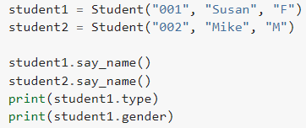


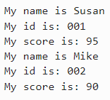
Class
Type student1.+TAB to see the defined attributes and methods
College of Engineering, Sungkyunkwan University

Slide 6
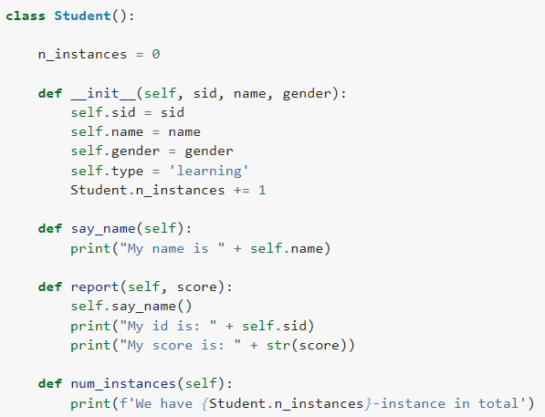
Class Attributes
Class attributes are shared by all instances
Instance attributes are accessed by self.attribute
n_instances keep the record of number of created instances
Class attribute is defined without using self
It is accessed by ClassName.attribute
College of Engineering, Sungkyunkwan University

Slide 7
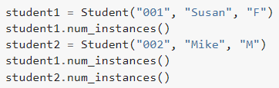

Class Attributes
College of Engineering, Sungkyunkwan University

Slide 8
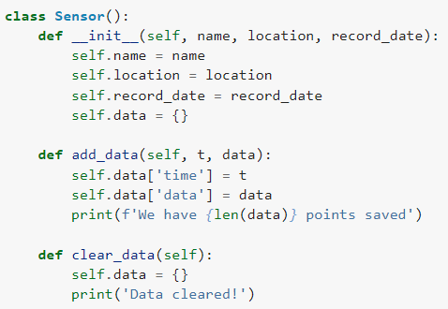
Inheritance
A class named Sensor
Attributes name, location, and record_date and an attribute data as an empty dictionary to store data
Create one method add_data with t and data as input parameters to take in timestamp and data arrays
College of Engineering, Sungkyunkwan University

Slide 9
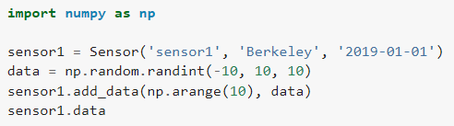

Inheritance
A class named Accelerometer
Shares the same attributes and methods as Sensor class
We can extend the attributes or methods
Add a new method show_type
College of Engineering, Sungkyunkwan University

Slide 10
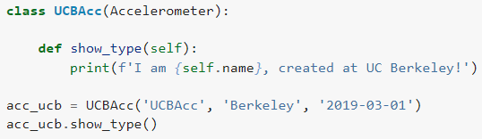
Inherit & Method Overriding
Overriding the method show_type
College of Engineering, Sungkyunkwan University

Slide 11
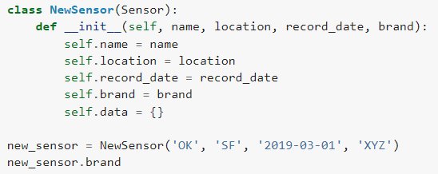
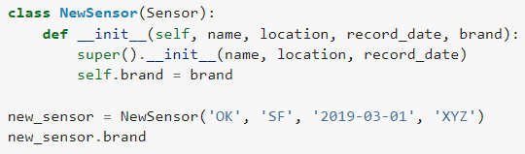
Parent Class
Updating attributes with brand
Redefining __init__ and overriding the parent function
Parent class or the superclass can be accessed by super
College of Engineering, Sungkyunkwan University

Slide 12
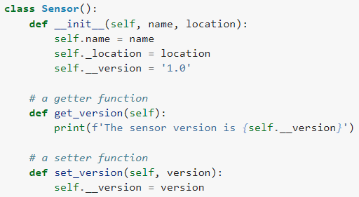
Encapsulation
Encapsulation helps:
Restrict access to attributes and methods in a class
Hide the complex details from the users
Prevent data being modified by accident
Private methods or attributes are defined using underscore as prefix, i.e. single “_” or double “__”
College of Engineering, Sungkyunkwan University

Slide 13


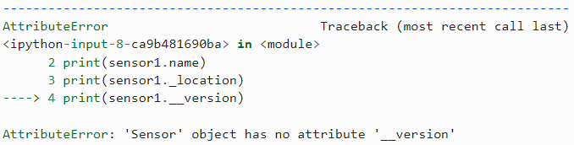


Encapsulation
Single underscore is a convention for private attributes and methods
With double underscore, the private attribute cannot be accessed or modified
We need to define getter and setter functions
College of Engineering, Sungkyunkwan University

Slide 14

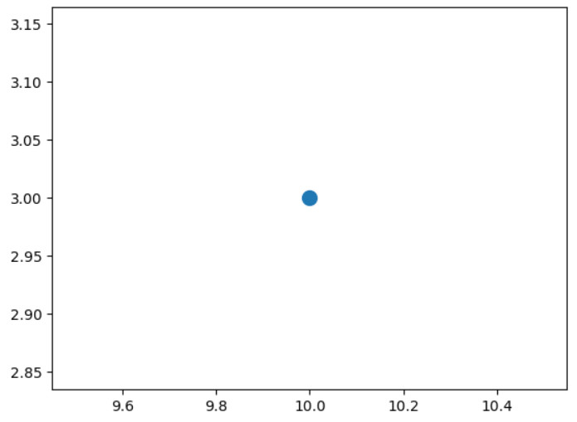
Assignment 9
Define the class Point that takes in the coordinate x, y. Add a method plot_point that plots the position of point.
Test Case
College of Engineering, Sungkyunkwan University

Slide 15



Assignment 9
Add a method calculate_dist to the class defined in the previous question which takes in x and y from another point, and returns the distance calculated between the two points.
Test Case
Define the class Polynomial which models a polynomial. Its attributes are the order of the polynomial n and coefficients coef which are input as a list. Add a method show which prints the polynomial in algebraic format and a method evaluate which evaluates the polynomial at a specific point x.
Test Case
College of Engineering, Sungkyunkwan University

Slide 16


Assignment 9
Define a class named Quadratic which is inherited from the class Polynomial. Override the initial function so that it is defined using three parameters a, b, and c. Extend the methods and define the method roots which returns the roots of the quadratic function.
Test Case
College of Engineering, Sungkyunkwan University

